Slide 1

Introducing
Music Tech 2024

Slide 2
Your teachers
Mr E Reed ereed@swchs.net
Miss Muir fmuir@swchs.net

Slide 3
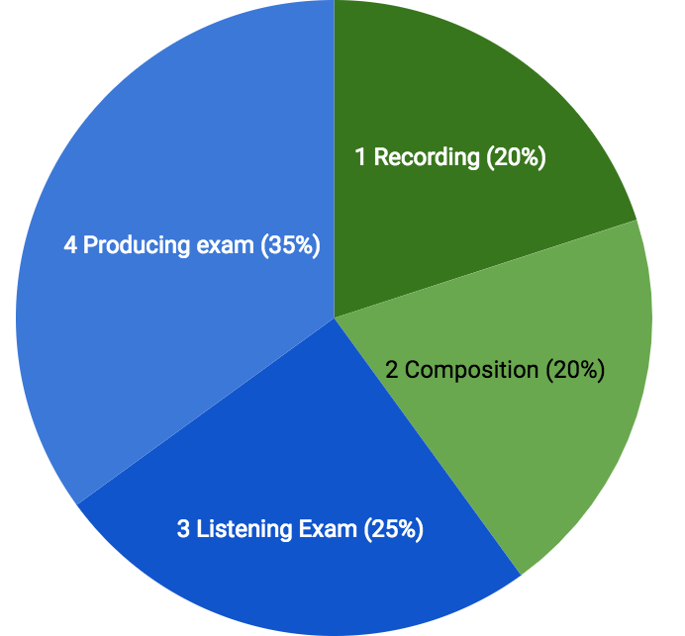

Slide 4
3–3 ½ minutes Chosen from a list of 10 artists
Manipulating performances, fixing things, adding effects...
2h15m
Long-answer question on a process, effect or hardware unit
3 minutes
Composing music to a video, or following a theme, or interpreting a text
Questions on unfamiliar recordings
2 long-answer questions
1h30m

Slide 5
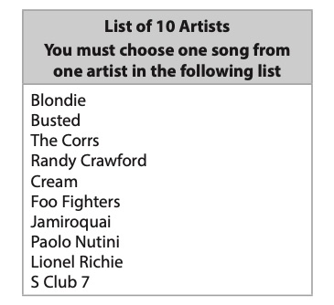
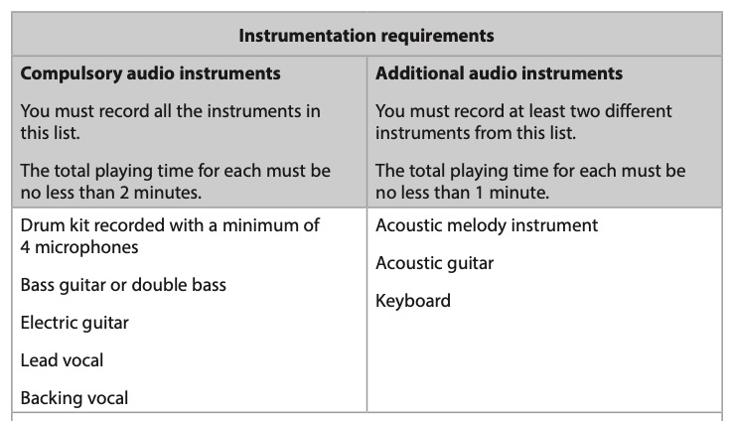
C1 Recording

Slide 6
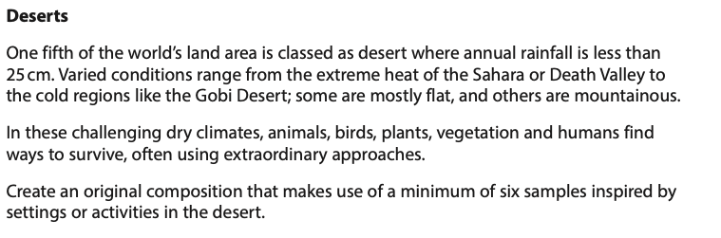
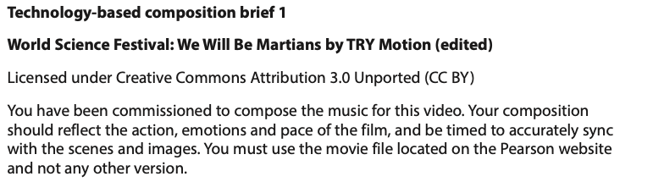

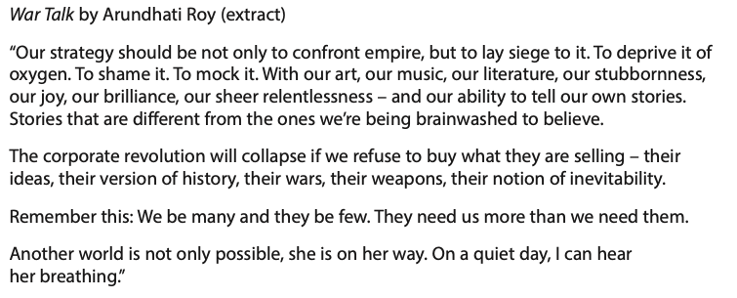
C2 Composition 2020 Briefs

Slide 7

C3 Listening and analysing Let’s try!
Compare the production techniques used in Version 1 and Version 2.
1
2

Slide 8
Analysis and comparison
Capture
Instruments
Dynamics
Effects
Release

Slide 9



Slide 10
C4 Producing and analysing
This is a picture of a recording session. Evaluate the studio techniques used.

Slide 11
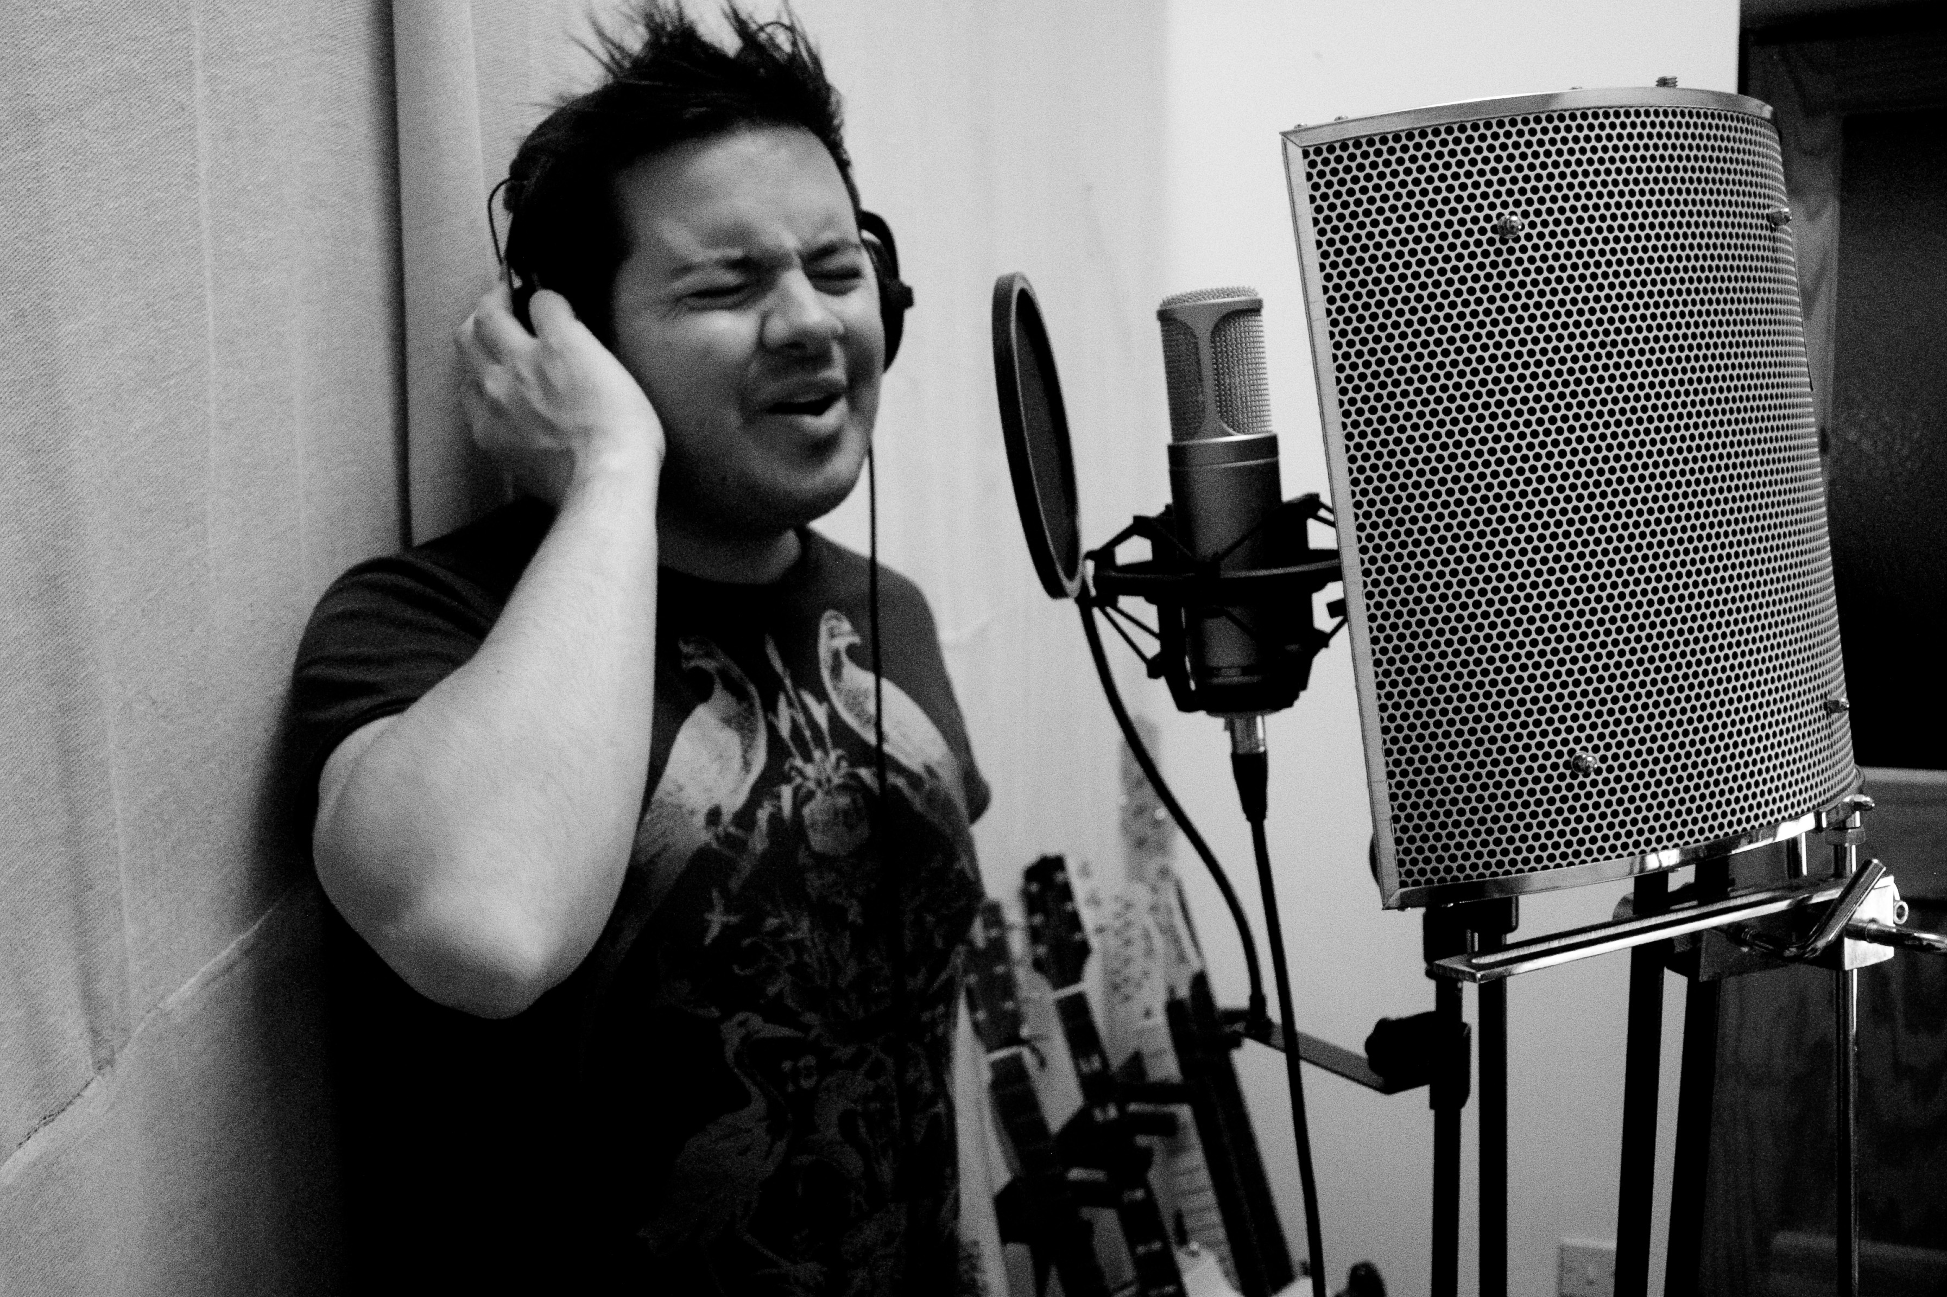

Slide 12
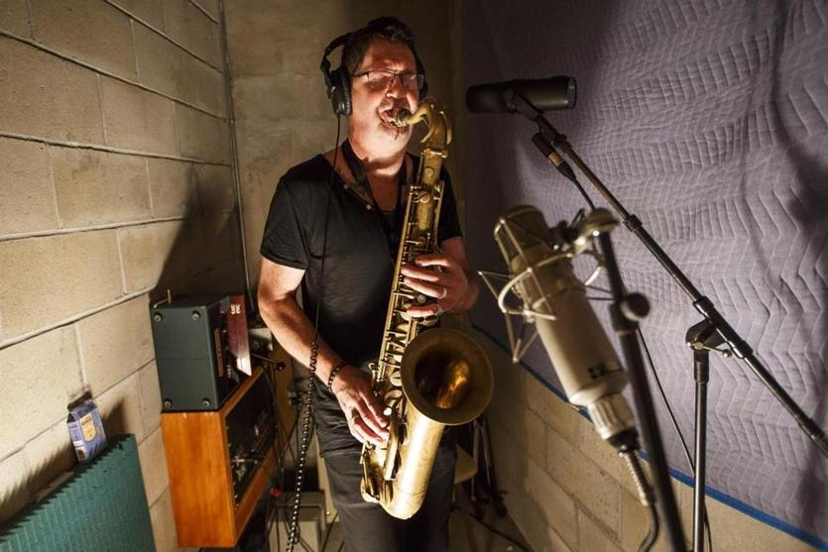

Slide 13
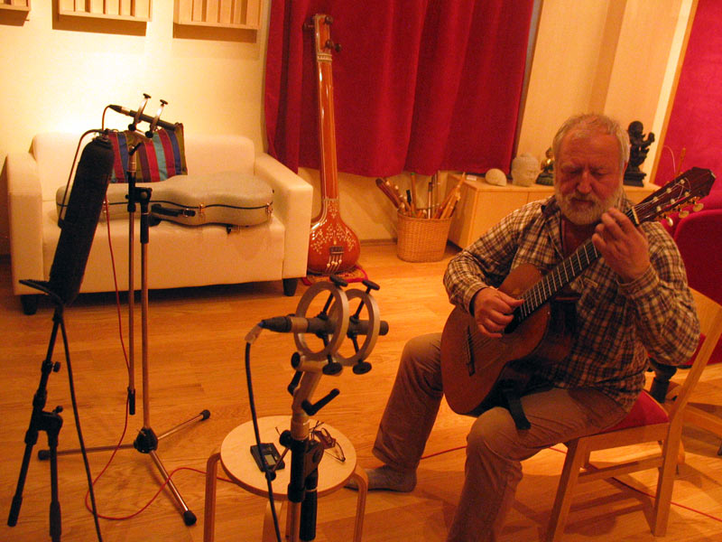

Slide 14
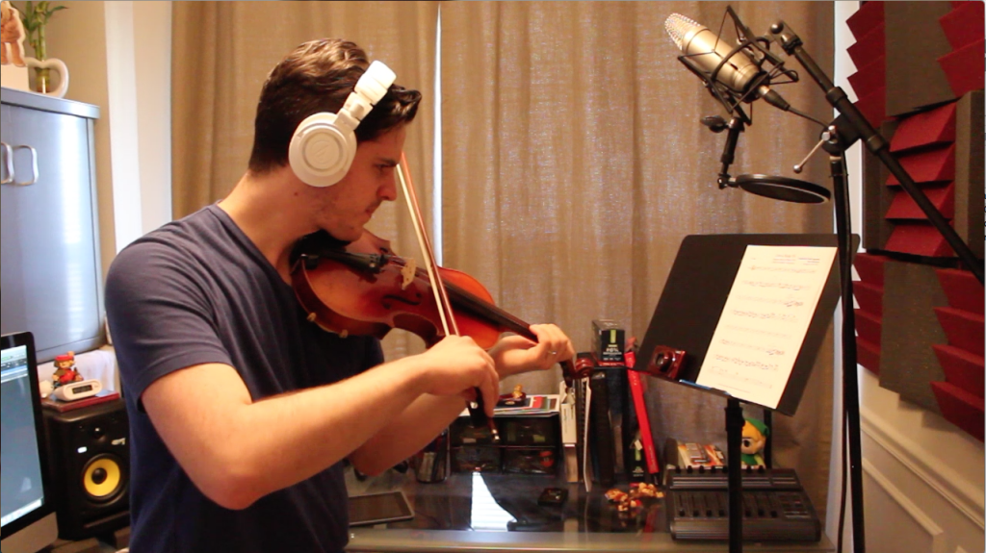

Slide 15

Preparing for September
Click me

